Slide 1
OGC API Tiles
Joan Masó (UAB-CREAF)
118th OGC Member Meeting
Virtual | 23 March 2021

Slide 2
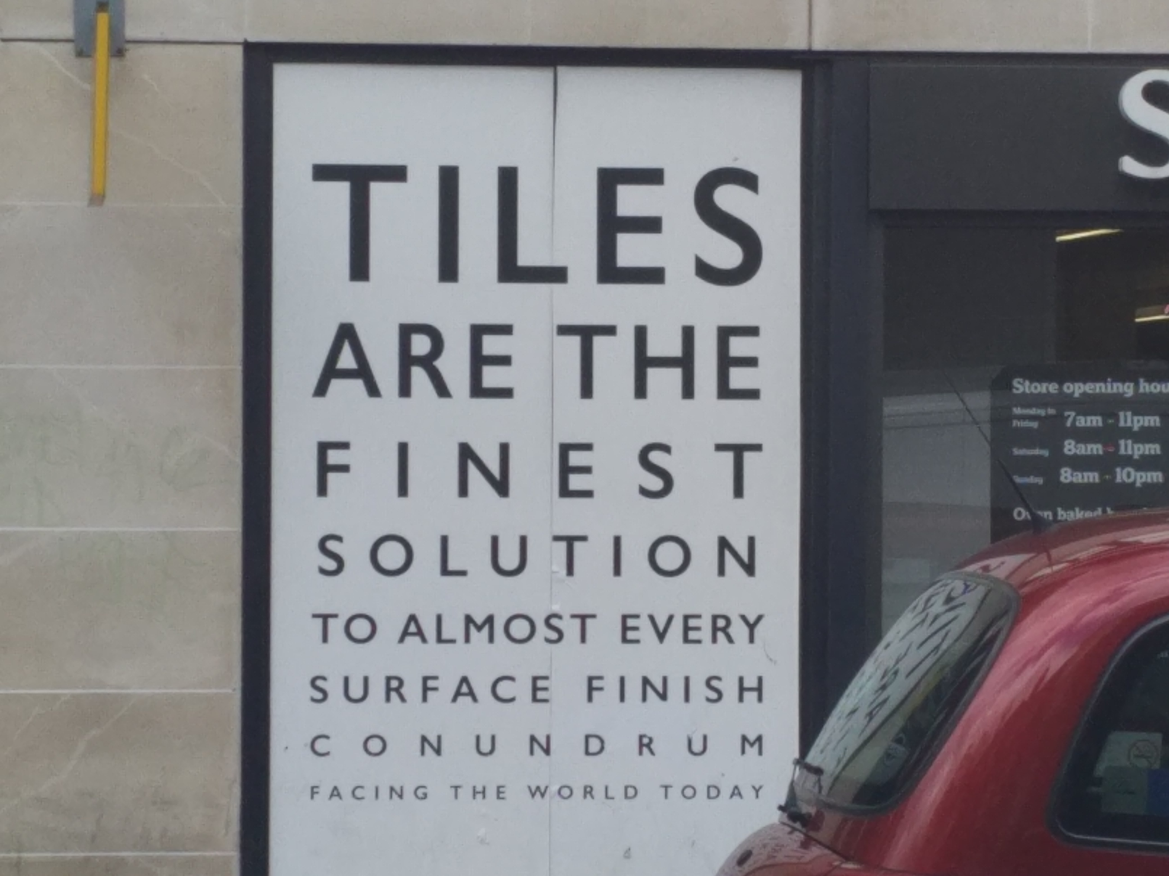
API

Slide 3
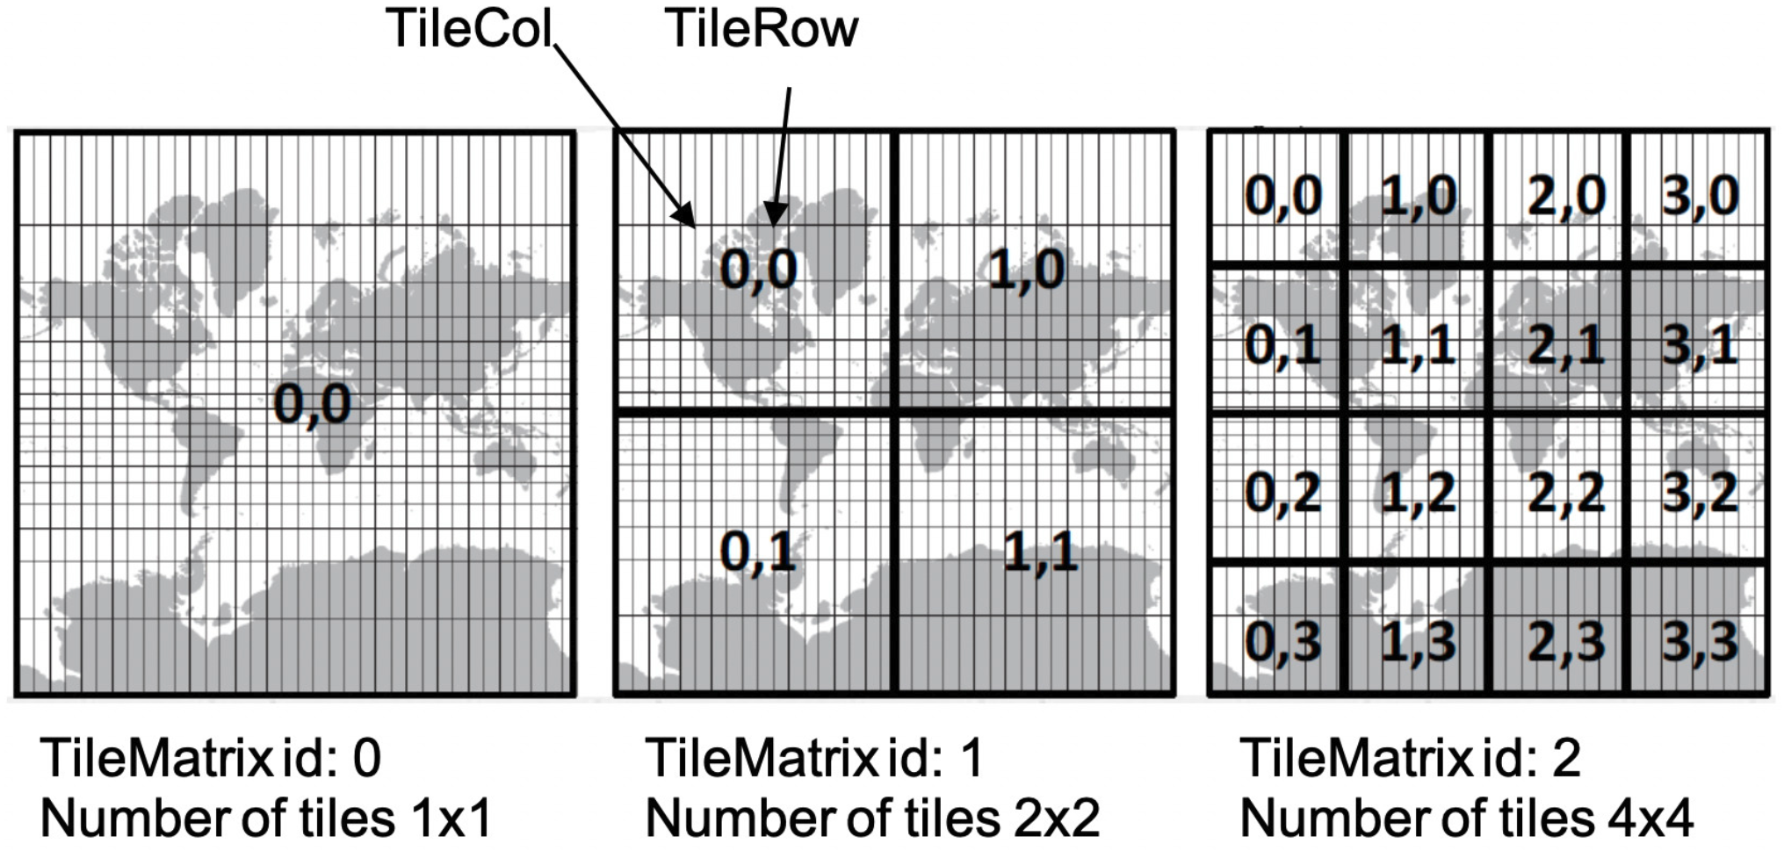
Tiling the world

Slide 4
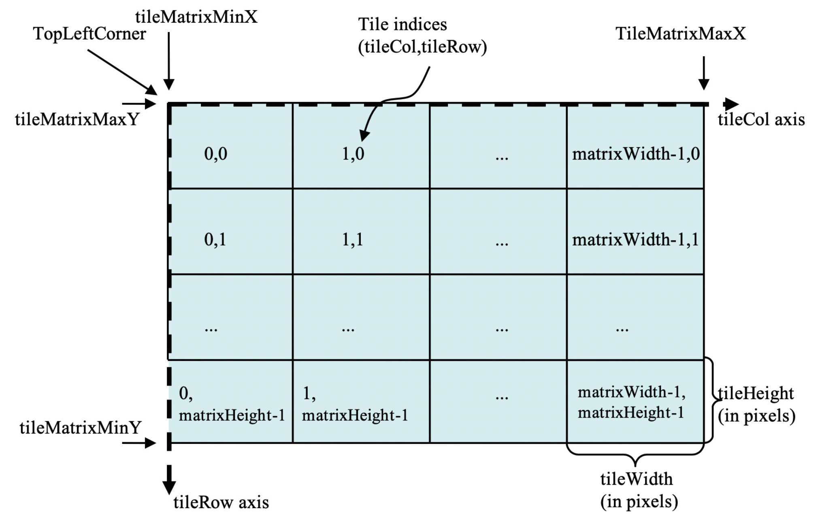

Slide 5
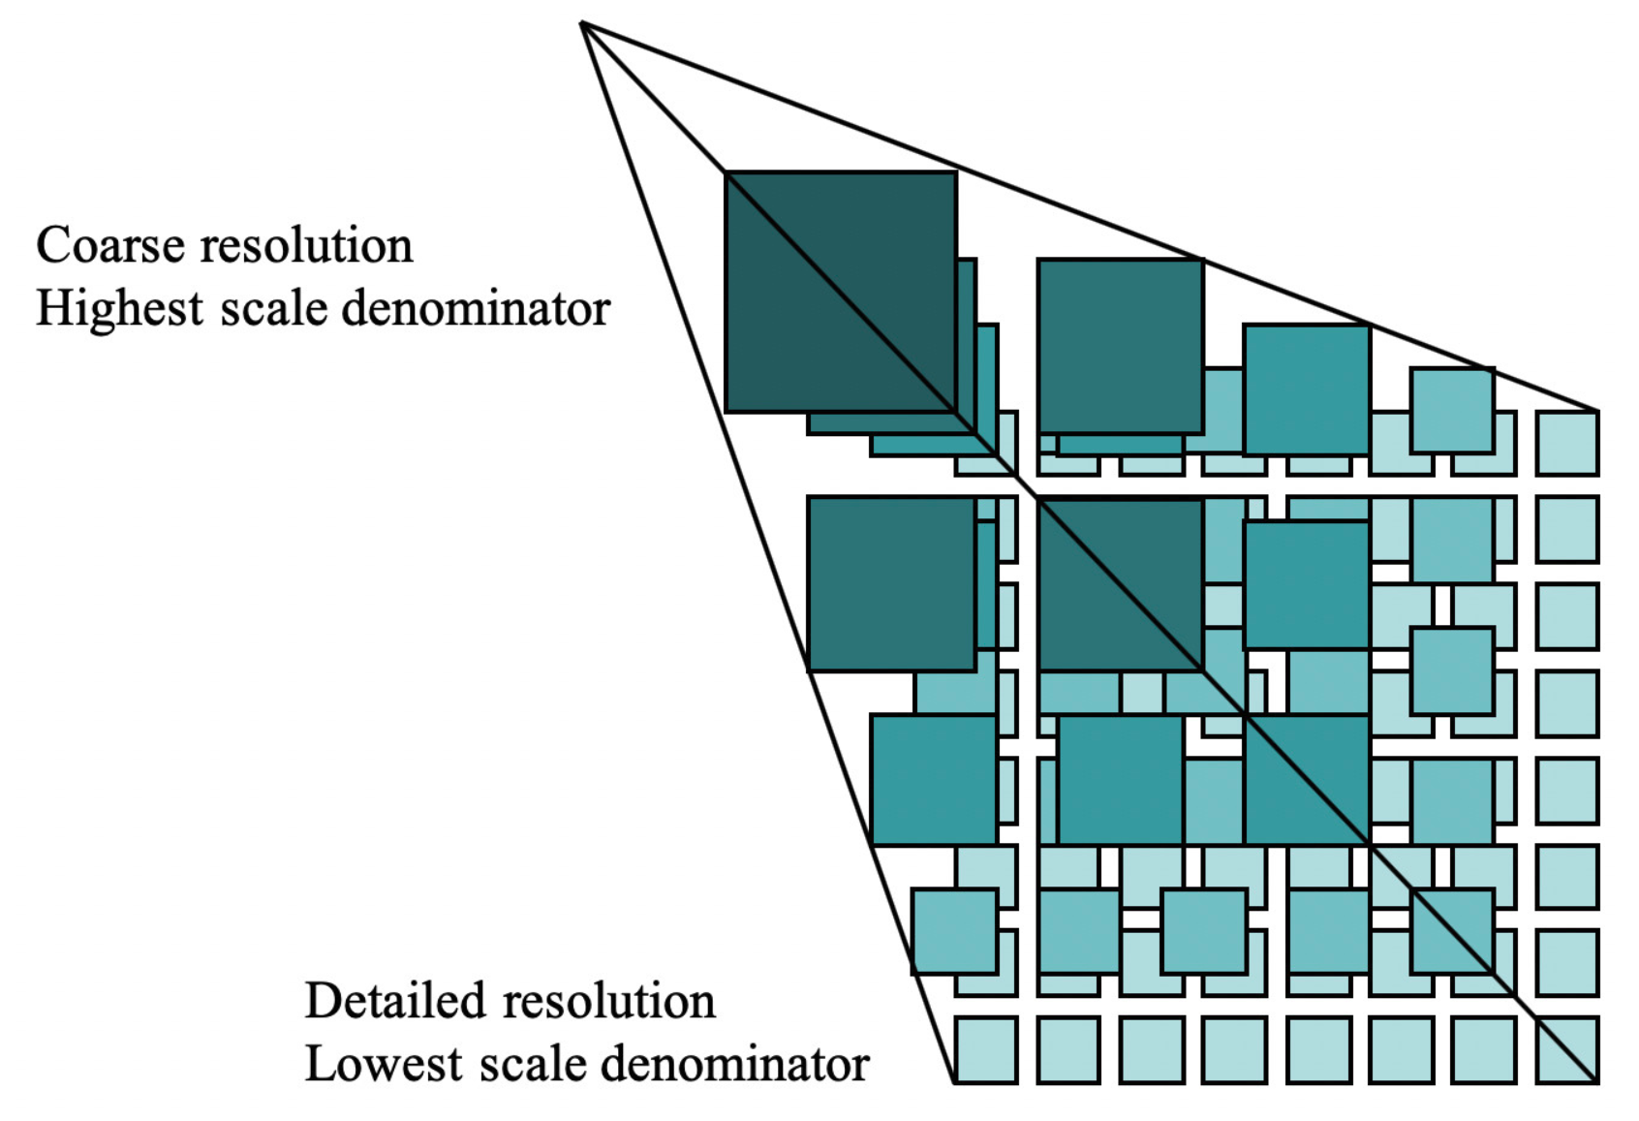

Slide 6
“Modern” standards we have
OGC API Maps Part 1, Part2…
OGC API Tiles
Part 1, Part 2…
OGC API Commons Part 1, Part2…
The Service
Two Dimensional Tile Matrix Set
17-083r2
Common Tile Matrix Set
In the Definition Servers
The Tiles and TileSet
Core tiling conceptual and logical model
19-014r1

Slide 7
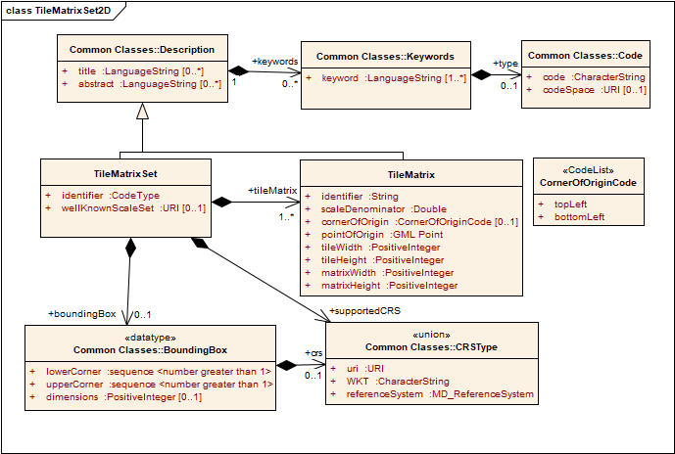
Tile Matrix Set

Slide 8
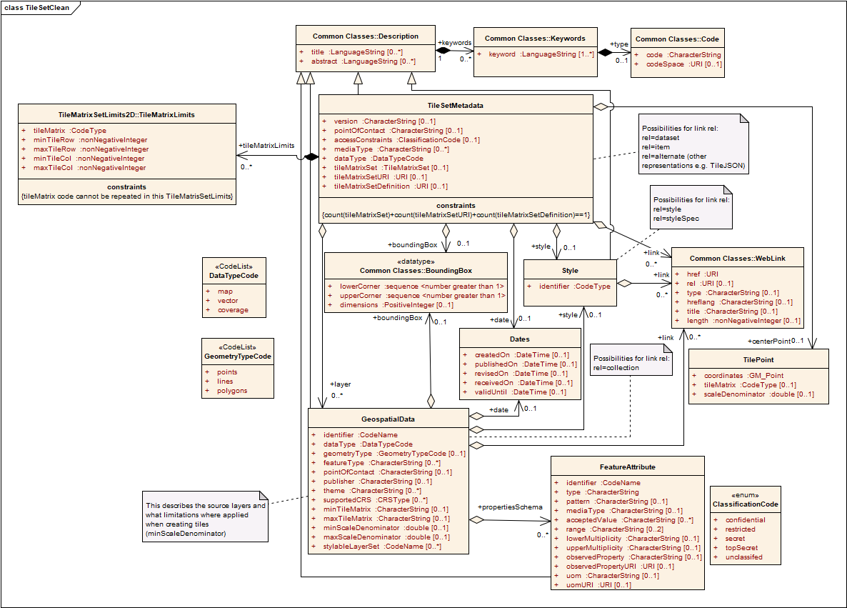
TileSet MD

Slide 9
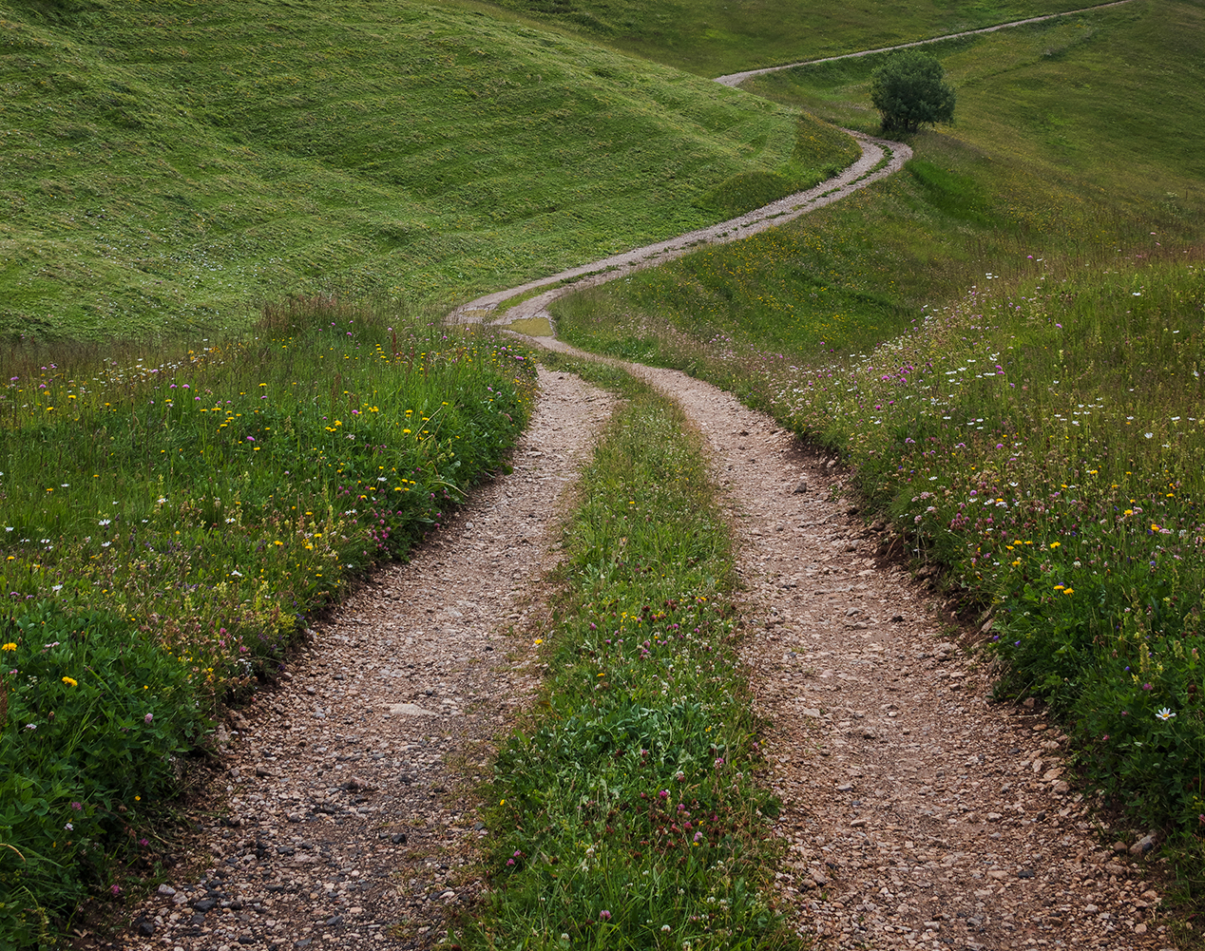
It is all about Paths
Like in real life...
...your path is not fixed.

Slide 10
Building blocks
(essential building block also for not OGC "people")
.../{tilemetrix}/{tilerow}/{tilecol}
(building block with tileset metadata)
.../tiles defined in OGC API tiles; tileset lists conformance class
.../tiles/{tilematrixsetid} defined in OGC API tiles; tileset metadata conformance class
.../tiles/{tilematrixsetid}/{tilemetrix}/{tilerow}/{tilecol}
(building block)
.../map defined in the OGC API maps; core (default style)
.../map?BBOX=... defined in the OGC API maps; bbox conformance class (default style)
(how to combine the two building blocks (maps, tiles))
.../map/tiles defined in the OGC API maps; tiles conformance class (has a default style)
A tile
TileSet(s) MD
A tile in a tileset
A map
A tile (rendered)

Slide 11
Apply the building blocs
(how to apply the tiles building block to a {datasetAPI})
{datasetAPI}/collections/{collectionId}/tiles defined in OGC API tiles; collection
{datasetAPI}/tiles defined in OGC API tiles; root (dataset)
{datasetAPI}/tiles?collections= defined in OGC API tiles; collections
(how to combine the two building blocks and apply them to a {datasetAPI} to get map tiles)
{datasetAPI}/collections/{collectionId}/map/tiles defined in OGC API tiles; collection
{datasetAPI}/map/tiles defined in OGC API tiles; root (dataset, default style)
{datasetAPI}/map/tiles?collections= defined in OGC API tiles; collections

Slide 12

Your life with style
{datasetAPI}/collections/{collectionId}/styles/{styleId}/map
{datasetAPI}/collections/{collectionId}/styles/{styleId}/map/tiles
{datasetAPI}/styles/{styleId}
A map
A tile
A style (SLD/SE)

Slide 13

Two ways of life
Improvise:
Just follow the lead of the links you discover
Plan ahead:
The OpenAPI agenda

Slide 14
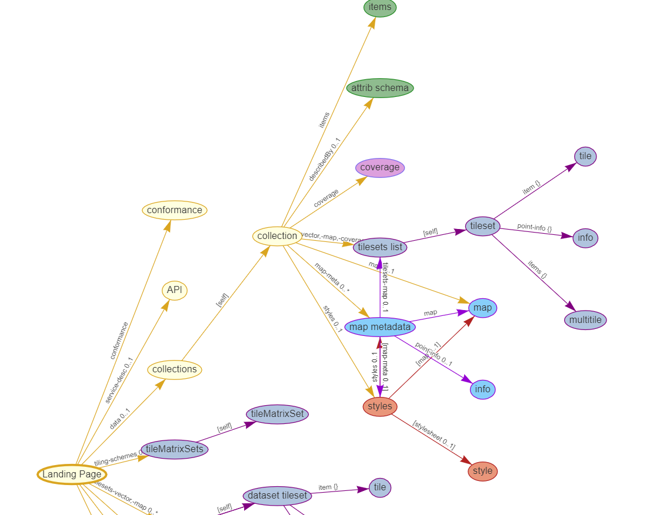
http://joanma.uab.cat/temp/graphs/OGCAPItiles.htm

Slide 15
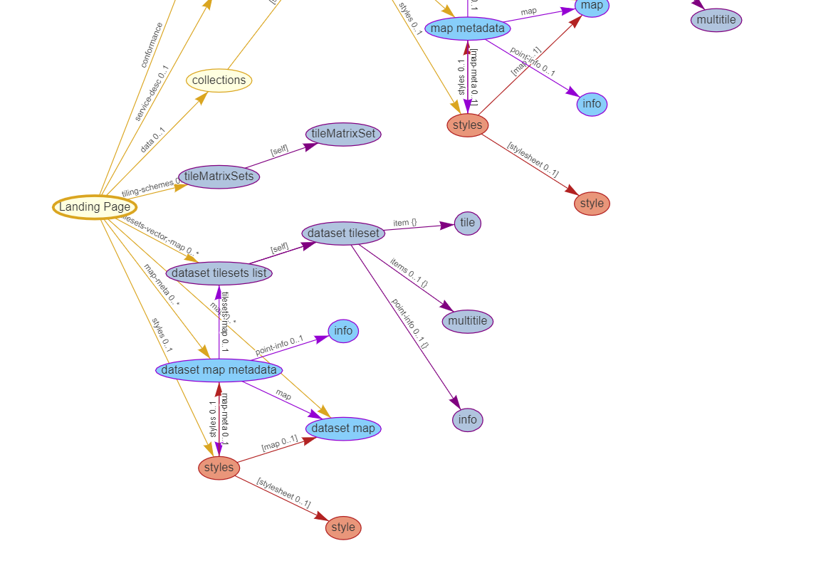
http://joanma.uab.cat/temp/graphs/OGCAPItiles.htm

Slide 16
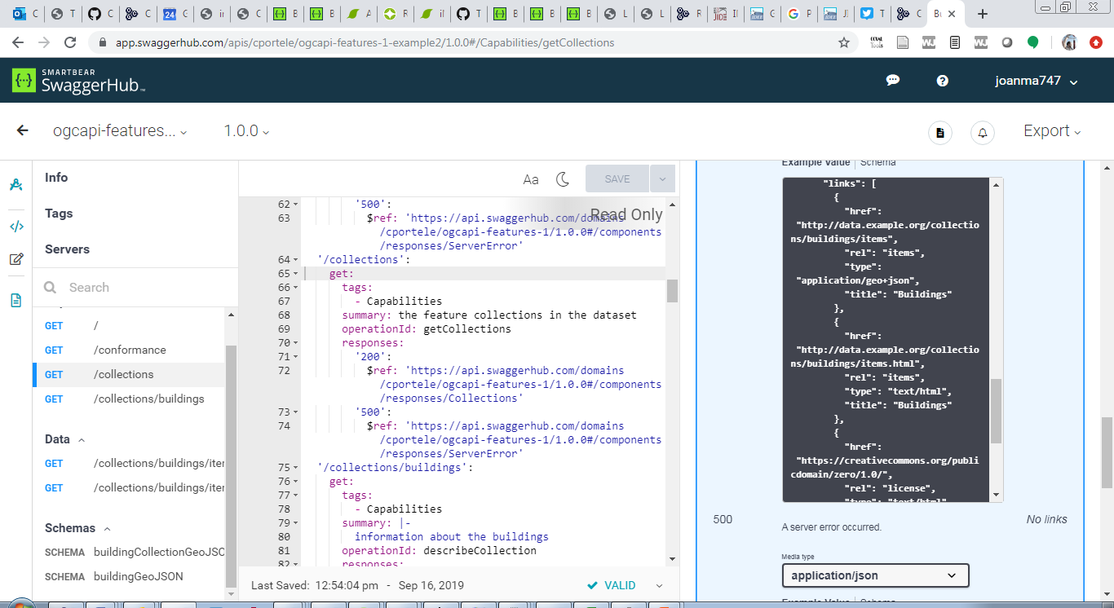
Two aproaches
Direct access to paths
Follow the links

Slide 17
Tiles and Maps applied to any resource
Tiles TMXS
Tileset
partition
partition
Tileset
Resource
Style
Map resource
subset
Maps BBox
GeoData-resource
(a collection)
Dataset-resource
(the root)

Slide 18
Requirements classes
Data Tiles
(incl. Vector Tiles)
Map Tiles
Map fragments
Maps Part 3: info
Maps Part 2: subset
Info
Map-tilesets
Tiles Part 1: core
Maps Part 1: core
GeoData-tilesets
GeoData-map
Maps Part 2: subset
Part 2:
Common collections
Subset
Dataset-tilesets
GeoData-selection
Dataset-map
Scaling
CRS
TilesetList
Part 1: Common core
Map
Metadata
Tileset
Tiles TMXS
Notes:
/collections/{collectionId}/time/20201213/elevation/123/map/{styleId}/{crsId}?bbox=width=height=
/collections/{collectionId}/map/{styleId}?crs=bbox=width=height=
/collections/{collectionId}/map/{styleId}/tiles "Requerir que tots els estils es tallin igual."
/collections/{collectionId}/tiles
/time/20201213/elevation/123/dim_band/3/map/{styleId}/{crsId}?bbox=width=height=
/map/{styleId}/tiles

Slide 19
Resources:
https://github.com/opengeospatial/OGC-API-Tiles
https://github.com/opengeospatial/OGC-API-Maps
https://github.com/opengeospatial/2D-Tile-Matrix-Set
OpenAPI Materials
API's examples
https://app.swaggerhub.com/apis/UAB-CREAF/ogc-api-map-tiles-opf-xmp-mt-more-1-collection/1.0.0
https://app.swaggerhub.com/apis/UAB-CREAF/ogc-api-maps-opf-xmp-more-1-collection/1.0.0
...
Domains
https://app.swaggerhub.com/domains/UAB-CREAF/ogc-api-maps/1.0.0
https://app.swaggerhub.com/domains/UAB-CREAF/ogc-api-tiles/1.0.0
...

Slide 20
